Slide 1
PROJECT REVIEW Heart Disease Diagnostic Analysis BY-ILEEN XAXA

Slide 2
agenda
Introduction
Offer Letter
About the Project
Data set
Software tools
Visualization
Insights

Slide 3
INTRODUCTION
Role: DATA ANALYST
At: Unified Mentor
Duration : 3 months (15-03-24 to 15-0624)

Slide 4
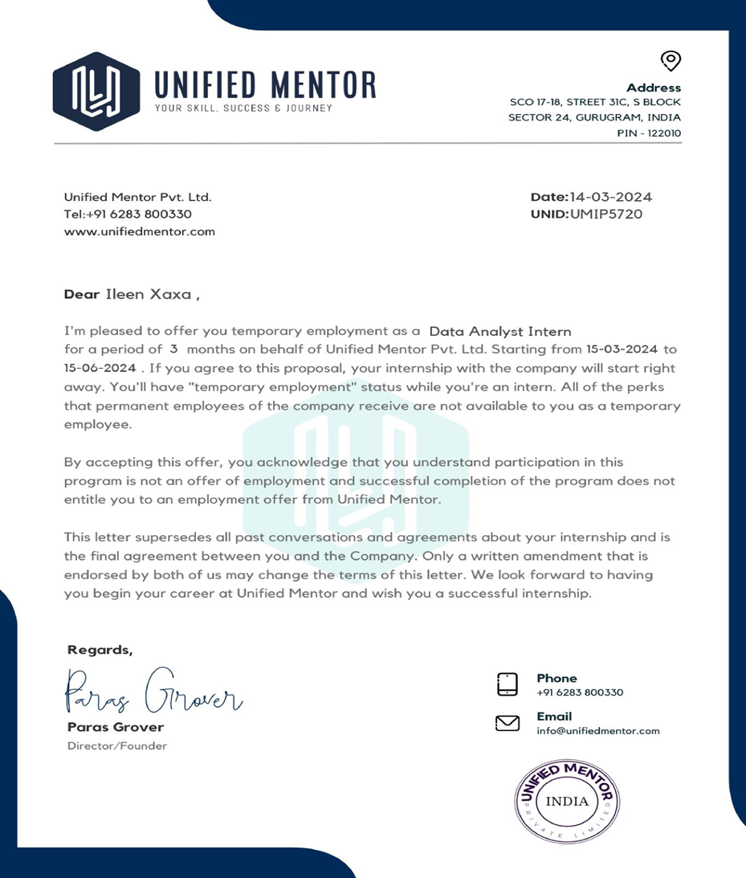
OFFER LETTER

Slide 5
ABOUT THE PROJECT
Background:Heart disease remains a leading cause of mortality worldwide, significantly impacting the quality of life and healthcare systems. Early detection and accurate diagnosis are crucial in managing heart disease, reducing complications, and improving patient outcomes. Traditional diagnostic methods, while effective, can be time-consuming, costly, and often require invasive procedures. With advancements in data science and machine learning, there is a potential to develop more efficient, non-invasive diagnostic tools that can aid healthcare professionals in early and accurate detection of heart disease.
Objectives: The primary objective of this project is to develop a predictive model that can accurately diagnose heart disease based on a set of clinical and demographic features. This model aims to leverage machine learning algorithms to analyze patient data and identify key indicators of heart disease, thereby providing a reliable diagnostic tool that can support clinical decision-making.

Slide 6
Tools
Python
Excel
Power bi

Slide 7
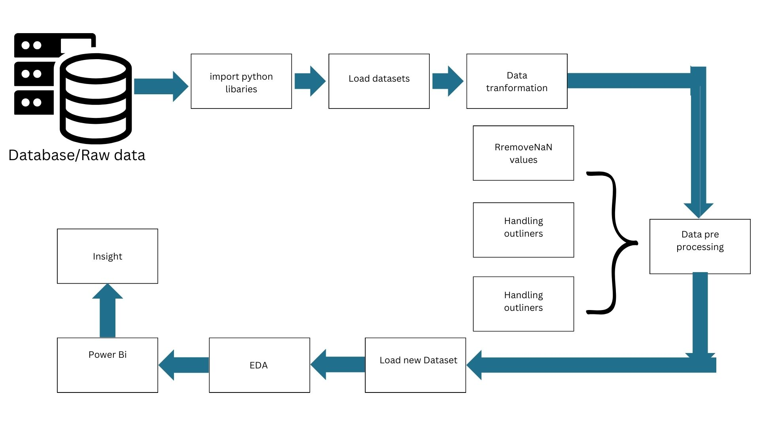
Architecture diagram

Slide 8
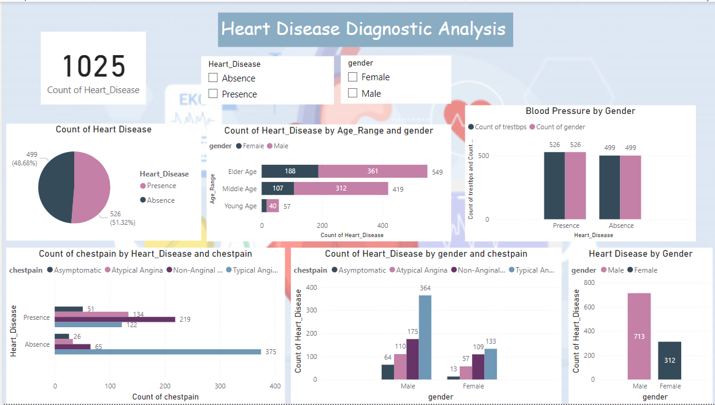
Dashboard -1

Slide 9
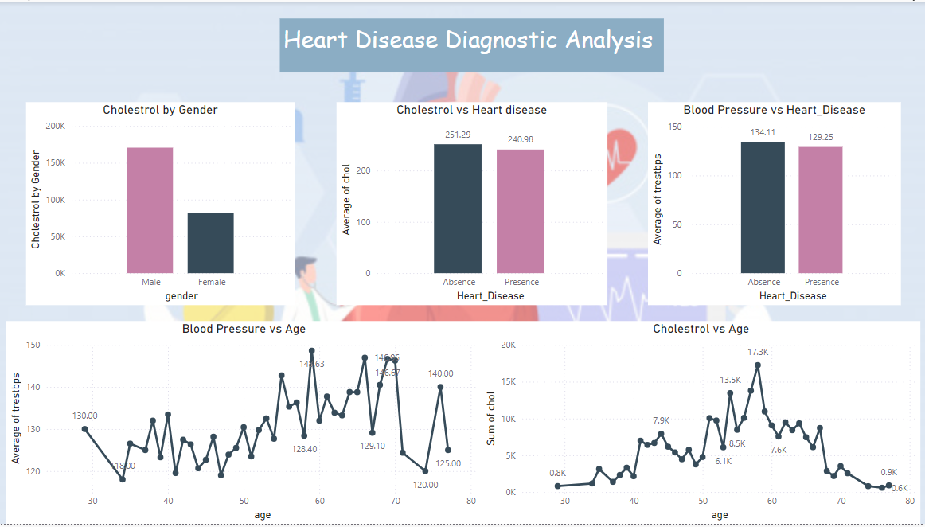
Dashboard -2

Slide 10
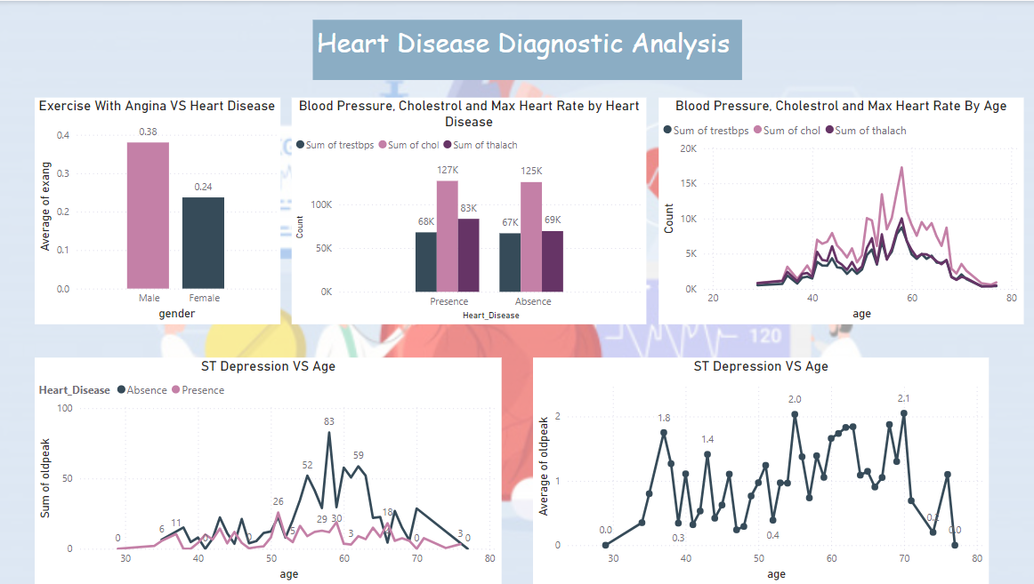
Dashboard -3

Slide 11
Insights
In this dataset the count of presence of Heart Diseases is 526 which is more than absence of Heart Disease 499.
Male of all age range has the higher count of heart disease 713 than female .
Male has higher number of cholesterol than Female.
Elder Age People are most affected by Heart Disease AND Middle Age People are mostly FREE from any kind of Heart Disease
We can see that Males are more prone to Heart Disease.
Blood Pressure Rate is almost equal in Males and Females.
females have little bit of higher cholesterol than males.
Higher Cholestrol Level results Chances Of Heart Disease.
Higher Blood Pressure Level results Chances Of Heart Disease
Cholestrol Increasing in the age group of 50-60

Slide 12
Thank you

